Slide 1
MODULE - 5
Data Communications and Networking

Slide 2
Multicast Routing
Unicasting
There is one source and one destination network.
One to one relationship.
Each router in the path of the datagram tries to forward the packet to one and only one of its interfaces.

Slide 3
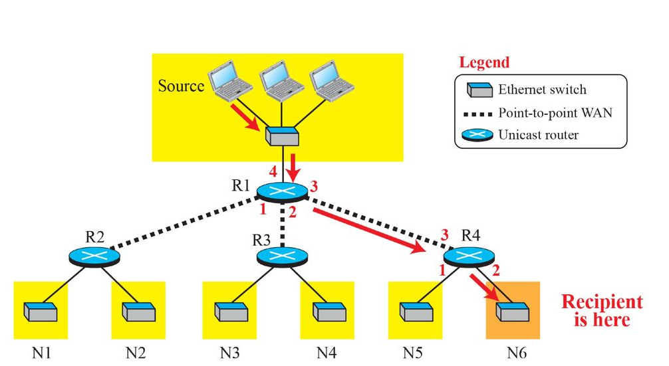
Unicasting

Slide 4
Multicasting
One Source and a group of destinations.
One to many relationship.
Here, source address is a unicast address.
The destination address is a group address, a group of one or more destination networks in which there is at least one member of the group that is interested in receiving the multicast datagram.
The group address defines the members of the group.

Slide 5
Multicasting Vs Multiple Unicasting
Multicasting starts with a single packet from the source that is duplicated by the routers.
The destination address in each packet is the same for all duplicates.
Only a single copy of the packet travels between any two routers.
In multiple unicasting, several packets start from the source.

Slide 6
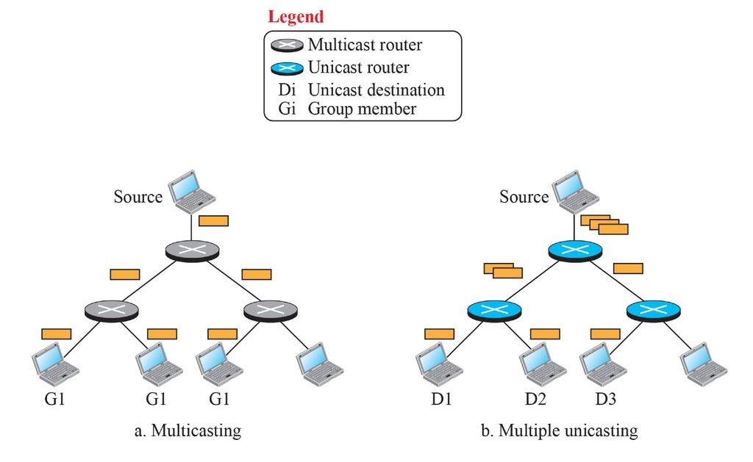
Multicasting Vs Multiple Unicasting

Slide 7
Multicast Applications
Access to distributed Databases: The information is stored in more than one location. The user who needs to access the database does not know the location of the information.
Information Dissemination: Business often need to send information to their customers. If the nature of the information is the same for each customer, it can be multicast.

Slide 8
Multicast Applications
Teleconferencing: It involves multicasting. The individuals attending a teleconference all need to receive the same information at the same time.
Distance Learning: Lessons taught by professor can be received by a specific group of students.

Slide 9
Multicast Addresses
When we send a unicast packet to a destination, the source address of the packet defines the sender and the destination address of the packet define the receiver of the packet.
In multicast, the sender is only one and the receiver is many.
We cannot include the addresses of all recipients in the packet.
The destination address of a packet, as described in the IP should be only one.

Slide 10
Multicast Addresses
For this reason we need multicast addresses.
A multicast address defines a group of recipients, not a single one.
It is an identifier for a group.
If a new group is formed with some active members, an authority can assign an unused multicast address to this group to uniquely define it.

Slide 11
Multicast Addresses
The source address of a packet in multicast communication can be a unicast address that uniquely defines the sender.
The destination address can be the multicast address that define a group.
A host which is a member of n groups, actually has (n+1) addresses.

Slide 12
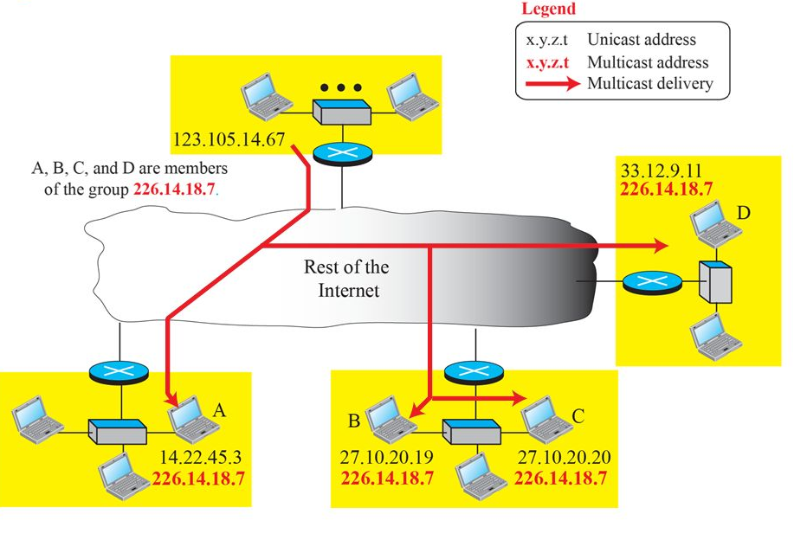
Multicast Addresses

Slide 13
Multicast Addresses in IPv4
A router or a destination host needs to distinguish between a unicast and a multicast datagram.
IPv4 and IPv6 each assign a block of addresses for this purpose.
Multicast addresses in IPv4 belong to a large block of addresses that are specially designed for this purpose.

Slide 14
Multicast Addresses in IPv4
In classful addressing, all of class D was composed of these addresses.
Classless addressing used the same block, but it was referred to as the block 224.0.0.0/24 (from 224.0.0.0 to 239.255.255.255).

Slide 15
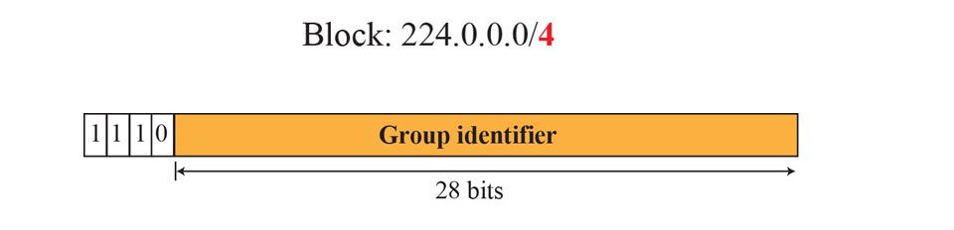
Multicast Addresses in IPv4
Four bits define the block.
The rest of the bits are used as the identifier for the group.
The number of addresses in the multicast block is huge (2²⁸).
We definitely cannot have that many individual groups.

Slide 16
Multicast Addresses in IPv4
The block is divided into several sub-blocks.
Each sub-block is used in a particular multicast application.
Some of the common sub-blocks are:
  Local network control block: The sub-block 224.0.0.0/24.
  Internetwork control sub-block: The sub-block 224.0.1.0/24.
  Source specific multicast (SSM) Block: 232.0.0.0/8
  GLOP Block: The block 233.0.0.0/8.
  Administratively Scoped Block: The block 239.0.0.0/8.

Slide 17
Delivery at DLL
In multicasting, the delivery at the internet level is done using network layer multicast addresses (IP addresses allocated for multicasting).
However DLL multicast addresses are also needed to deliver a multicast packet encapsulated in a frame.

Slide 18
Delivery at DLL
Network with multicast support
Most LANs support physical multicast addressing.
Ethernet is one of them.
An Ethernet physical address (MAC) is six octets (48 bits) long.
If the first 25 bits in an Ethernet address are 00000001 00000000 01011110 0, this identifies a physical multicast address for the TCP/IP protocol.
The remaining 23 bits can be used to define a group.

Slide 19
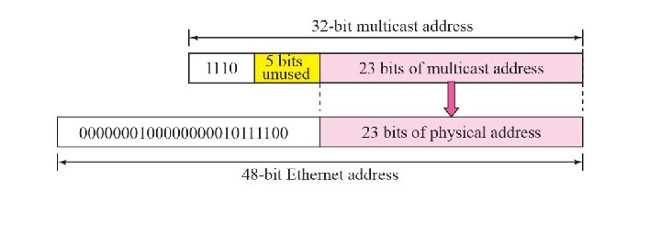
Delivery at DLL
Network with multicast support
The group identifier of a multicast address block in an IPv4 address is 27 bits long.
Which implies that 5 bits are unused.

Slide 20
Delivery at DLL
Network with No multicast support
Most WANs do not support multicast addressing.
To send a multicast packet through these networks, a process called tunneling is used.
Here the multicast packet is encapsulated in a unicast packet and sent through the network.
It will be emerged as a multicast packet at the other end.

Slide 21
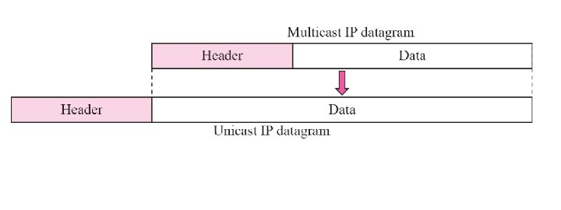
Delivery at DLL

Slide 22
Multicast Forwarding
Two different aspects are there:

Slide 23
Two Approaches to Multicasting
Source-Based Tree Approach:

Slide 24
Two Approaches to Multicasting
Group Shared Tree Approach:

